Slide 1
Module IV
Information Systems, Green IT strategy and metrics

Slide 2
Approaching Green IT Strategies
The conceptual framework for green IT strategies discussed in this chapter is based on earlier ideas by Unhelkar and Dickens (2008) and further refined by Unhelkar (2011).
In addition to the green IT strategies discussed here, a few other green IT frameworks are worth considering.
To model an enterprise from an environmental perspective, Philipson (2009) has refined RMIT University’s original framework for green IT (Molla, 2009) into a comprehensive green IT framework that can be used in practice.
A procedural model towards sustainable information systems management (Murugesan, 2007, 2008a, 2008b; Schmidt et al., 2009; Worthington, 2009) contributed to these models and frameworks for green IT, resulting in valuable input into the development of a green IT strategy.

Slide 3
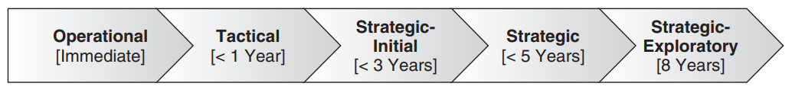
An important consideration in developing a green IT strategy is the timeframe of its influence.
For example, if the organization only views ‘IT as Producer’ of carbon footprint, then simple measures like switching off monitors and computers when not in use can be brought about immediately.
A more strategic approach to carbon footprint reduction will involve other measures and take a longer timeframe to achieve.
Given the urgency of reducing the carbon footprint and complying with legislation, business is often faced with the need to implement tactical solutions to meet immediate needs and showcase the benefits of green IT, which may then become the incumbent or are replaced by longer term solutions (Sherringham and Unhelkar, 2011).

Slide 4
Effective green strategies result from an approach that cuts across all the tiers and silos of an organization.
Such strategies come from individual understanding, leadership, vision, knowledge about the organization’s structure and dynamics, awareness of the organization’s operational nuances and people’s (i.e. stakeholders’) attitude toward change.
The green strategic mindset acknowledges these vital initial efforts especially for the visibility they add to the initial effort, and it adopts a long-term, integral, all-encompassing effort.
Green ICT can be used to both deliver tactical solutions for businesses to obtain some quick gains and meet legislative needs as well as enable longer term strategic solutions across a group of organizations that form a green business ecosystem.

Slide 5
Operational (immediate)
Simple, immediate action taken by an organization with respect to green IT.
For example, switching off the computer monitors when not in use or not printing on paper whenever possible are immediate actions, also called the low-hanging fruits.
Whilst these are the most visible actions, they do not require what is considered a strategic approach.
Simply inform users that they need to switch off computers when not in use, or implement an internal method to charge the users’ cost centre for the use of paper.
Feedback in terms of carbon usage per action, developing a consensus amongst a group of users and initial training is helpful in getting these operational green IT initiatives off the ground.
Many early adopters of green IT have done precisely this.
Tactical (within one year)
At a tactical level, the organization needs about one year to build up its ability to reduce carbon emissions.
Examples of these tactical actions include the replacement of the organization’s existing computer monitors with green, flat-screen monitors, or replacing mobile gadgets and networking equipment within a year.
Similarly, recycling programmes can be put together by managers for their respective departments that will encourage staff to have processes for recycling paper and reducing printing.

Slide 6
Strategic-initial (within three years)
The three-year timeframe for impact of green IT initiatives is based on strategic initiatives. These initiatives would include the senior leadership of the organization including a dedicated ‘C-level’ role (such as a chief sustainability officer).
These green IT strategies are formulated and approved by the board, have substantial budgetary backing and are based on a holistic approach to greening that included the organization’s data centres, buildings, supply chains, disposal strategies and even sales and marketing.
Implementing green policies, using software and applying metrics will provide tremendous value to a green enterprise transformation – and that value will itself be maximized by keeping a 3–5-year timeframe for implementing those strategies and plans.
Strategic (within five years)
This green IT strategy is a further extension of the aforementioned three-year strategy but has greater depth and breadth of coverage.
For example, in addition to reengineering efforts over the three-year period, this strategy would also bring about a complete attitude change in people at all levels, reorganize the business architecture and implement substantial governance mechanisms for the board.
The physical infrastructure, such as buildings and data centres, will also undergo a major revamp in this period.

Slide 7
Strategic use of carbon data involves not only collecting and reporting data, but also identifying risks and opportunities associated with the greening and also plotting trends and patterns in terms of internal carbon savings and external carbon credits and trading.
Green IT strategies thus expand into the areas of capacity planning for the organization, resourcing and skills (human resource) strategies, technology acquisitions, risk management and governances.
Furthermore, the organization will be influenced by and, in turn, influence other partnering organizations through collaborative efforts.
Renewable energy sources are explored and consumed – with fully automated, systems-based measurement, reporting and monetizing.
Strategic-exploratory (within eight years)
A green IT strategy over an eight-year time period will have to continuously explore the possibilities of carbon reduction and strive to align them with the business, which would also be changing over that time period.
Therefore, such a long-term approach would require strategists to imagine the future in terms of technologies and business and incorporate it into the green IT strategy.
Such explorations are important, especially for large and global organizations as well as government bodies, as they result in a think tank–based output that enables organizations to prepare for multiple, futuristic technologies.

Slide 8
For example, such organizations will have the resources to create prototypes and measure the impacts of, say, nanotechnologies and biomimicry (technologies that mimic nature to get the best carbon results) on their carbon emissions.
Coming close to a decade in future, one would expect the carbon economy to be a truly mainstream economy (with carbon trading on the stock exchange) requiring organizations to deal with carbon in all of their processes, people and technologies.
Carbon trading in future is inevitable, and the carbon factor will play a crucial role in the stock exchange of the future.
Therefore, one of the most crucial considerations for an organization’s decision makers is to engender a change of mindset from a tactical one to a strategic one.
This is an inherently challenging situation in a market-driven economy, where all micro- and macro-economic levers are pulled by the organization to boost its share prices.

Slide 9
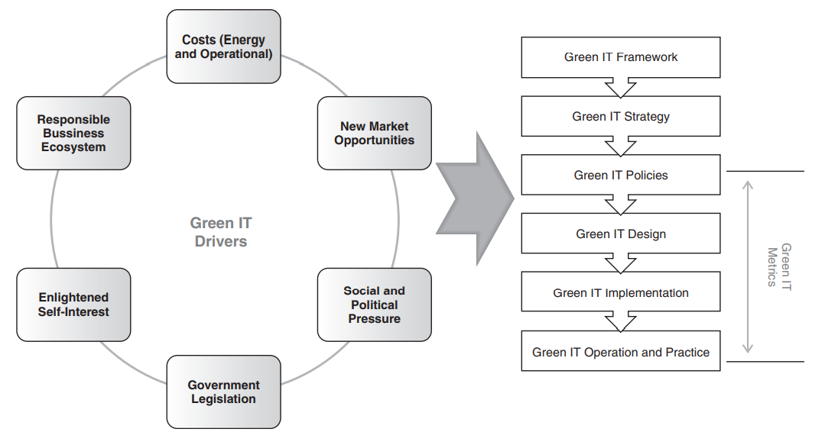
Business Drivers of Green IT Strategy

Slide 10
Cost Reduction
Cost reductions provide an excellent driver for an organization to come up with a comprehensive green IT strategy.
As a result of a green initiative, cost reduction could be derived from minimizing energy consumption (improving energy efficiency), reducing the use of raw materials and equipment, recycling equipment and waste and optimizing storage and inventory.
Whilst efforts to reduce costs can provide an impetus for carbon emission reduction, organizations undertaking green transformations need to be aware of the investment that they must incur as a result of their greening effort.
For example, optimizing a business process can eliminate the need for a desktop machine but, instead, there may be a need to replace that desktop with a mobile device.
Virtualizing a data centre, whilst improving resource utilization and reducing cooling costs, will require some initial investment from the business for implementing virtualization.
At the organizational level, costs associated with a green enterprise transformation programme need to be factored in along with the anticipated cost reduction due to the transformation.

Slide 11
Demands from Legal and Regulatory Requirements
Government rules and regulations comprise a major driver for many green enterprise transformation programmes.
The relative importance given to the regulatory factor, as compared with other factors such as organization self-initiation, customer demand and pressure from society, are the highest – 70% as reported by Unhelkar (2011).
Regulatory acts such as National Greenhouse and Energy Reporting (NGER) (www.climatechange.gov.au/reporting; Australian Government, 2011a) and the Carbon Pollution Reduction Scheme (CPRS) (www.climatechange.gov.au) require organizations to mandatorily report their carbon emissions if they are above a certain threshold level.
Regulatory bodies also provide some basic calculators to enable greenhouse gas calculations.
An example one such calculator is the NGER calculator OSCAR (Online System for Comprehensive Activity Reporting; Australian Government, 2011b).
These calculators are used to determine an organization’s total carbon emissions that can be used to decide whether the organization will require mandatory reporting.
In addition to the basic calculators, green information systems also source external regulatory data (such as permissible emissions figures), and store, analyse and broadcast the results that enable an organization to monitor and improve its performance.
These organization-specific green information systems are more sophisticated than the basic calculators provided by the regulatory bodies (Unhelkar and Philipson, 2009).

Slide 12
Sociocultural and Political Pressure
Sociocultural and political pressure become major driving forces when an organization’s society recognizes the environment as of significant value and is interested in protecting it.
Such acceptance of the environment’s importance by the society brings pressure on the organization to change.
For example, the increasing popularity of and adherence to Earth Hour (last Saturday of March in most countries), wherein almost all large edifices around the world switch off their electrical power for all non-essential things for an hour, or Earth Day (22 April in the United States and 20 March by the United Nations) have a corresponding bearing on many large businesses’ sustainability strategies.
This ‘groundswell’ of opinions also leads to corresponding shifts in political viewpoint.
As a result, the organization is forced to seriously reconsider its business priorities and processes in light of the environment.
Whilst the scale and nature of the benefits of such CSR for an organization can vary depending on the nature of the enterprise, and are difficult to quantify (Garito, 2011), their importance should not be discounted.

Slide 13
Enlightened Self-Interest
Self-interest comes into play when an organization, on its own accord, realizes the need to be, and the benefits of being, environmentally responsible and creates or adopts a green strategy.
It may include a range of interests including the organization’s desire to undertake a genuine common good, the need of business leadership to achieve personal satisfaction or maintain or raise employee morale or simply the decision makers’ understanding that costs can be reduced and customers more satisfied with a self-interest approach that also helps the environment.
The desire to achieve brand recognition based around environmental sustainability or an understanding of its impact on business continuity also forms part of this driver (Cartland, 2005).
This driver can thus translate into self-motivation and has the potential to be an effective green driver for businesses.
A variation of this driver, known as incentive-driven compliance (IDC), incorporates innovation and self-motivation within its environmental approach for better carbon compliance.

Slide 14
Collaborative Business Ecosystem
If a large organization that has myriad different associations with its many collaborating smaller sized organizations changes its direction and priorities, then those collaborating organizations also have to change their priorities accordingly.
When such a large organization embarks on environmentally sustainability programmes in a major way encompassing its supply chain, an entire ecosystem made up of the business partners, suppliers and customers and internal users organizations, together with the industry and the corresponding business consortiums in which the organization exists, is affected.
These various stakeholders and associations are invariably pushed into implementing environmentally responsible initiatives and strategies.
This happens by virtue of the multiple interactions – physical and electronic – that are undertaken in the course of daily business activities.
This scenario is demonstrated by HP, wherein not only are the environmental impacts monitored and managed by the organization, but also, by virtue of its own management and active involvement with the members of its supply chain, the overall carbon impact of the activities of HP’s suppliers is also reduced (Velte, Velte and Elsenpeter, 2008).
In addition to the impact of collaborating organizations in a business ecosystem, there are also considerations of superimposition of long-term trends upon short-term markets (Goel et al., 2011).
Such superimpositions bring about major business changes and restructuring in favour of ideas that are environmentally friendly.

Slide 15
New Market Opportunities
Global environmental awareness, corresponding legislations and sociocultural and political pressure on businesses have created opportunities for new markets that did exist or were not even envisaged a few years ago.
For instance, these new markets can create and provide products and services that assist other organizations in achieving their green initiatives and goals.
Thus, we are talking about not only ‘businesses that are green’ but also ‘green as a business offering’.
For example, carbon emissions management software (CEMS) is a new breed of software applications that are now available.
The developers of these new software applications have discovered a market that did not exist before.
Similarly, smart meters to measure carbon emissions, opportunities to apply new standards for the optimization of emissions and new architecture and design of low-carbon gadgets comprise markets that are likely to grow in the carbon economy.
Despite the discussion on the aforementioned drivers for businesses to undertake green initiatives, practical experience suggests that these green strategy drivers are usually interpreted by organizations in their own ways.

Slide 16
For example, as described by Godbole (2011), within the health care sector, hospitals have significant challenges with disposal of hazardous waste, whilst insurance companies are more concerned with reducing paper use or decreasing power consumption in their data centres.
Thus, in practice, these drivers will result in a combination of drivers for the business to initiate green IT – depending on what it considers as its own key environmental and business issues.
In the development of a green IT strategy, not only do these drivers need independent analysis, but also they need to be studied together to see their overall impact on the organization.

Slide 17
Multilevel Sustainable Information
Sustainability requires information on the use, flows and destinies of energy, water and materials including waste, along with monetary information on environment-related costs, earnings and savings.
This type of information is critical if we are to understand the causal relationships between the various actions that can be taken and their impact on sustainable performance.
However, the problem is broad in scope and the necessary information may not be available, or may be difficult to collect.
Improving sustainability performance, especially through changing the way an organization or activity operates, requires a number of practical steps which will include the need for a systematic approach for information gathering and analysis.
In order to tackle the problem, it is important to break it down into smaller, manageable pieces by adding boundaries and scopes to activities to make them more manageable.
A ‘boundary’ or ‘scope’ can be drawn narrowly for a specific activity (e.g. to consider only the emissions that arise directly from that activity) or broadly (including emissions indirectly associated with the activity).

Slide 18
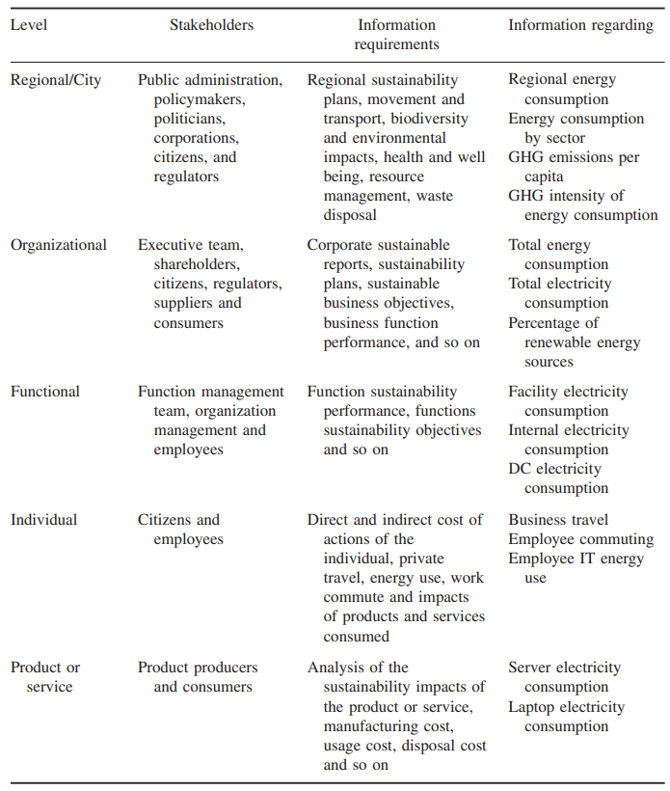

Slide 19
We will look at the problem of sustainability from the perspective of a multilevel information problem, where individual levels are used to provide a scope and boundary for activities.
Information can flow between levels as necessary, allowing the granularity of the problem to be set as needed.
This allows the sustainable information to be tackled at high or low levels of detail.
In order to avoid a myopic view of the benefits of sustainable information and to understand its real impacts, we must first understand and examine the bigger picture of sustainability.

Slide 20
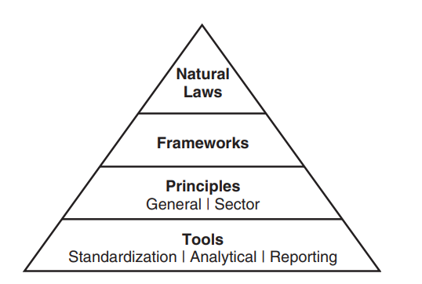
Sustainability Hierarchy Models

Slide 21
Natural laws: The laws imposed upon us by Mother Nature such as the Law of Conservation of Mass and Energy, Law of Entropy and Laws of Thermodynamics. Frameworks: High-level conceptual rules for sustainability that conform to natural laws.
Principles: General and sector-specific guidelines that detail sustainable practices and actions.
Tools: Methodologies, standards and strategies for implementation.
As natural laws are well described by their respective disciples, for the remainder of this section we will focus on the bottom three levels of the hierarchy, starting with frameworks for sustainability.

Slide 22
Sustainability Frameworks
In order to improve the understanding and communication of sustainability issues and to provide high-level definitions of sustainability, a number of frameworks have been proposed.
Natural Capitalism, The Natural Step, Ecological Footprint and the triple bottom line (TBL) are popular frameworks and are described.
These frameworks are used to reach a shared mental model of sustainability, providing concrete definitions and scoping for concepts and terms (Hitchcock and Willard, 2008).
The frameworks can be used to develop high-level visions and planning for sustainability activities.

Slide 23
Natural Capitalism
The concept of Natural Capitalism, an extension of the economic concept of capital to the natural environment (Hawken, Lovins, and Lovins, 1999), is to look at the environment as a system that yields a valuable flow of goods and services (e.g. fish, trees and other such things).
Natural capitalism requires the following shifts in business practices: Radically increase productivity in the use of natural resources;
shift to biologically inspired production models and materials;
move to a ‘service-and-flow’ business model; and reinvest in natural capital.

Slide 24
The Natural Step
The objective of The Natural Step (Nattrass and Altomare, 1999) is to help reduce the potential causes of environmental problems.
This framework defines four system conditions, derived from the Laws of Thermodynamics, for a sustainable society.
In a sustainable society, nature’s functions and diversity must not be systematically subjected to
increasing concentrations of substances extracted from the Earth’s crust,
increasing concentrations of substances produced by society and
degradation by physical means.
resources must be used fairly and efficiently to meet the basic needs of people worldwide.

Slide 25
Ecological Footprint
The ecological footprint (Rees, 1992; Wackernagel and Rees, 1996) is the measure of environmental impact of particular actions on the Earth’s natural resources and ecosystem functionality.
It compares human demand with the Earth’s ecological capacity to regenerate.
The assessment can be used at the individual, city or regional level to estimate how much of the Earth (or how many planet Earths) it would take to support humanity if everybody lived a given lifestyle.

Slide 26
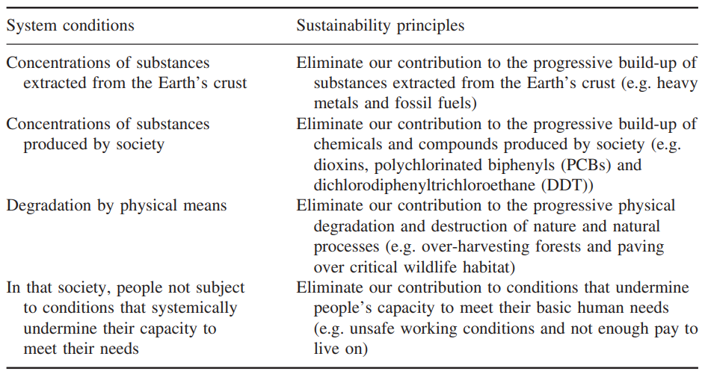

Slide 27
Triple Bottom Line (TBL)
The TBL framework (Elkington, 1998) allows an organization to focus on not only its economic bottom line, but also its environmental and social ‘bottom lines’.
TBL expands the scope of responsibility for an organization from shareholders and owners to also include stakeholders – anyone who is influenced, either directly or indirectly, by the actions of the organization.
Other sustainability frameworks include cradle to cradle (McDonough and Braungart, 2002), biomimicry (Benyus, 1997), social return on investment (Scholten and Olsen, 2006) and the sustainability helix.

Slide 28
Sustainability Principles
Below the high-level frameworks are a broad range of principles that provide guidance on the sustainability practices needed to achieve the objectives set out in higher level frameworks.
Principles are typically created via a group or community process with the aim to produce a number of aspirational statements to provide guidance (often common sense) on sustainability.
General principles for sustainability are broad guidelines that can be applied within any domain or sector.
Two well-known general principles, mentioned in this section, are the 3 Rs and Earth Charter.
Sector-specific principles complement general principles with guidance to help translate what sustainability means within the context of a sector such as government, international business or higher level education.

Slide 29
Reduce, Reuse and Recycle (3R’s)
Reduce, Reuse and Recycle are three waste management strategies that are used collectively within a waste hierarchy known as the 3 Rs.
The 3 Rs classify the strategies according to the desired order of use: It is better to reduce than reuse, and better to reuse than recycle.
The aim of the waste hierarchy is to extract the maximum practical benefits from products and to generate the minimum amount of waste.

Slide 30
Earth Charter
The Earth Charter is an international declaration on the principles needed to build a just, sustainable and peaceful global society.
The Earth Charter proposes that environmental protection, human rights, equitable human development and peace are interdependent and indivisible.

Slide 31
Tools for Sustainability
At the bottom of the hierarchy are the sustainability tools that provide guidance and best practices.
Sustainability tools come in many forms, from methodologies used to help determine the environmental impact of a steel water bottle, to certifying the design and construction of a building.
Sustainability tools can be general purpose, such as the GHG Protocol for emissions reporting, or specific to a sector, like the Leadership in Energy and Environmental Design (LEED) for green building certification.
These tools provide sustainability information needed to make sustainable decisions and drive sustainable behaviour.
Many of these tools can be classified as IT for green or as an opportunity for IT to ‘green’ processes or activities outside of IT.

Slide 32
Product Level Information
Understanding the impacts of a product or service requires an analysis of all potential impacts associated with a product, process or service for its entire life cycle.
This is achieved using a technique known as life cycle assessment.

Slide 33
Life-Cycle Assessment
Life-cycle assessment (LCA), also known as life cycle analysis, is a technique to systematically identify resource flows and environmental impacts associated with all the stages of product and service provision.
LCA provides a quantitative cradle-to-grave analysis of the products or services’ global environmental costs (i.e. from raw materials through materials processing, manufacture, distribution, use, repair and maintenance and disposal or recycling).
The demand for LCA data and tools has accelerated with the growing global demand to assess and reduce GHG emissions from different manufacturing and service sectors (Horne, Grant, and Verghese, 2009).
LCA can be used as a tool to study the impacts of a single product to determine the stages of its life cycle with most impact (Levi Strauss & Co., 2009).
LCA can also be used as decision support when determining the environmental impact of two comparable products or services.

Slide 34
The Four Stages of LCA
Goal and scope definition:
It is important to ask the right question to ensure whether the LCA is successful.
The first step in this process is the framing of the key questions for the assessment.
Typical steps include defining the goal(s) of the study, determining what type of information is needed to inform decision makers, defining functional units (environmental impact, energy efficiency, life span, cost per use, etc.), defining the system boundaries and studying perspective, allocation principles, environmental impact assessment categories and level of detail.

Slide 35
Inventory analysis:
The second phase involves data collection and modelling of the product and service system with process flow models and inventories of resource use and process emissions.
The data must be related to the functional unit defined in the goal and scope definition and include all data related to environmental (e.g. CO2) and technical (e.g. intermediate chemicals) quantities for all relevant unit processes within the study boundaries that compose the product system.
Examples of inputs and outputs include materials, energy, chemicals, air emissions, water emissions, solid waste, radiation and land use.
The results of a life cycle inventory provide verified information about all inputs and outputs in the form of elementary flow to and from the environment from all the unit processes involved in the study.

Slide 36
Impact assessment:
The third phase evaluates the contribution to selected impact assessment categories, such as ‘climate change’, ‘energy usage’ and ‘resource depletion’.
Impact potential of the inventory is calculated and characterized according to the categories.
Results can then be normalized across categories (same unit) and weighted according to the relative importance of the category; both of these actions are voluntary according to the ISO standard.
Interpretation:
The final phase involves interpretation of the results to determine the level of confidence and communicate them in a fair, complete and accurate manner.
This is accomplished by identifying the data elements that contribute significantly to each impact category, evaluating the sensitivity of these significant data elements, assessing the completeness and consistency of the study and drawing conclusions and recommendations based on a clear understanding of how the LCA was conducted and the results were developed (Skone, 2000).

Slide 37
CRT Monitors versus LCD Monitors: Life Cycle Assessment
A comprehensive environmental LCA of the traditional cathode ray tube (CRT) and newer liquid crystal display (LCD) monitors was conducted through the EPA’s Design for the Environment (DfE) programme.
The objective of the study (Socolof, Overly, and Geibig, 2005) was to evaluate the environmental and human health life cycle impacts of functionally equivalent 17 in. CRT and 15 in.
LCD monitors. The study assessed the energy consumption, resources input and pollution produced over the lifetime of the equipment.
The cradle-to-grave analysis was divided into three stages:
cradle to gate (manufacturing),
use and
end of life (disposing or reusing).
Each stage was assessed for the energy consumed, materials used in manufacturing and associated waste.
Components manufactured in different locations, where energy sources can differ due to the way local energy is produced, such as coal versus nuclear, were taken into account.
In summary, the LCA concluded that LCD monitors are about 10 times better for resource usage and energy use, and five times better for landfill use.
However, LCDs are only 15% better for global warming because the LCD manufacturing process uses sulphur hexafluoride, a significant GHG.

Slide 38
Individual Level Information
In a similar manner to other levels, understanding impacts at the level of an individual requires a holistic view of activities.
Primary sources of emissions for an individual will include the life cycle of products and services they purchase and use, the construction (LCA of material and construction) and operation of their residence (energy use, water use and waste disposal and recycling) and private travel (especially emissions from long-haul flights).
The ability for individuals to understand the impacts of their activities is critical.
Online carbon calculators are a popular mechanism to calculate impact; however, these may have significant limitation including static calculation, a lack of personalization and limited capacity for historical analysis.
However, tools are improving for individuals.
For instance, home energy usage is an area that has seen the early adoption of real-time monitoring systems with the on-going development of smart meters and the Smart Grids.
Studies have shown that energy conservation improves if residents receive real-time feedback on their energy usage; one study in Ontario showed the average household reduced its electricity usage by 6.5% (Mountain, 2006).
Another interesting development is the utilization of smart phones as a low-cost means to determine the impacts associated with commuting.

Slide 39
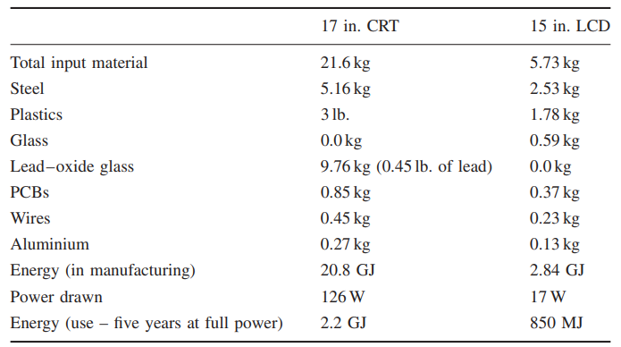

Slide 40
A significant contribution to CO2 emissions levels is the daily commute by an individual.
In response to addressing this challenge, a group of Volvo employees wanted to develop an IT solution that would motivate people to reduce the emission cost of their daily commute by measuring the time, efficiency and environmental impact of their commuting.
By using a small application on mobile phones, Volvo turned the device into a CO2 pedometer to calculate the environmental impact of each commute, whilst helping them to make the right daily choices of transport modes towards efficiency and sustainability.
In a 2009 pilot, Volvo employees were able to reduce their CO2 footprint by 30% in just one month’s time. This app was transformed into a global service and launched as Commute Greener!, which is able to help companies, cities and individuals around the world understand how to commute in a greener way (Commute Greener, 2010).
The system aggregates the commute data of individuals to build commute patterns that are useful for decision making at higher levels, for understanding the commute pattern within a city or for providing information for a company.
This information can be used to optimize public transport, company shuttles and carpooling.
Efforts such as Commute Greener and Smart Grids show how tracking information at the individual level can benefit the individual directly, and also be aggregated at a higher level of analysis to benefit a region or community.

Slide 41
Functional Level Information
An organization typically comprises multiple functions or operating divisions and departments including marketing, finance, operations, human resources and research and development.
Sustainability issues at the functional level are related to business processes and the value chain; they involve the development and coordination of resources through which the overall organization’s objectives and goals can be executed efficiently and effectively.
A close relationship exists between organization level and functional level metrics, and it is important that metrics at both levels be aligned.
Typically, metrics at the functional level will be more granular to provide specific detail on the operations of the function.
Functional level metrics can then be aggregated into an organization level metric.
Monitoring energy usage for an IT function can involve metrics around building energy usage (lights and heat), staff computer energy usage and in particular energy used within data centres.

Slide 42
Data Centre Energy Efficiency
The power needs of data centres may range from a few kilowatts for a rack of servers in a closet, to several tens of megawatts for large facilities.
Power usage in a data centre goes beyond the direct power needs of servers to include networking, cooling, lighting and facilities management.
The US Environmental Protection Agency (EPA) estimates that servers and data centres are responsible for up to 1.5% of the total US electricity consumption (EPA, 2007) or roughly 0.5% of US GHG emissions for 2007.
The same report also highlights that significant power consumed by data centres is not used on computation; for every 100 W supplied, only 11.2 W were used for computation.
With electricity costs the dominant operating expense of a data centre, it is vital to maximize the centre’s operational efficiency to reduce both the environmental and economic costs (Belday et al., 2008).

Slide 43
Data Centre Power Metrics
Developed by the Green Grid, power usage effectiveness (PUE) is a measure of how efficiently a data centre uses its power.
PUE measures how much power the computing equipment consumes in contrast to cooling and other overheads uses.
PUE is defined as follows:
PUE = Total Facility Power/IT Equipment Power
The reciprocal of PUE is data centre infrastructure efficiency (DCiE) and is defined as follows:
DCiE = 1/PUE = IT Equipment Power/Total Facility Power × 100%
IT equipment power includes the load associated with all of the IT equipment, such as compute, storage and network equipment, along with supplemental equipment used to monitor or otherwise control the data centre including Keyboard Video Mouse (KVM) switches, monitors, workstations and laptops.
Total facility power includes everything that supports the IT equipment load such as power delivery (uninterruptible power supply (UPS), generators, batteries, etc.), a cooling system (chillers, computer room air conditioning units (CRACs), direct expansion air handler (DX) units, pumps and cooling towers), compute, network, storage nodes and other loads such as data centre lighting.

Slide 44
Emerging Data Centre Metrics
When assessing the financial health of a business, one should not look at one metric in isolation.
The same is true for assessing the efficiency of a data centre.
Whilst PUE and DCiE have proven to be effective industry tools for measuring infrastructure energy efficiency, there is a need to measure the operational effectiveness of the data centre.
To this end, a number of metrics are under development to measure dimensions including resource utilization and environmental impact.
Each of these metrics provides data centre operators more visibility into where opportunities for further efficiency improvements exist.

Slide 45
Carbon usage effectiveness (CUE):
Measures data centre–specific carbon emissions, which are emerging as an extremely important factor in the design, location and operation of a data centre.
CUE, combined with PUE, can assess the relative sustainability of a data centre to determine if any energy efficiency and/or sustainable energy improvements need to be made.
Note: CUE does not cover the emissions associated with the data centre or the building itself.
CUE is define as:
CUE = CO2 emitted (kgCO2 eq)/unit of energy (kWh)) × (Total Data Centre Energy/IT Equipment Energy)
Energy reuse effectiveness (ERE):
Many data centres are now recovering waste energy from their operations and reusing it outside of the data centre such as heating office space or homes.
Since PUE does not consider these alternate uses for waste energy, the ERE metric is used.
ERE = (Total Facility Power − Power Reuse)/IT Equipment Power

Slide 46
Data centre energy productivity (DCeP):
DCeP quantifies useful work compared to the energy it requires.
It can be calculated for an individual IT device or a cluster of computing equipment.
DCeP is a sophisticated metric where useful work and energy are compared relative to a user-defined time limit.
DCeP = Useful Work Produced/Total Data Centre Energy Consumed over time
Data centre computer efficiency (DCcE):
DCcE – and its underlying submetric, server compute efficiency (ScE), enables data centre operators to determine the efficiency of their compute resources, which allows them to identify areas of inefficiency.
The metric can reveal unused compute resource within a data centre making it easier for data centre operators to discover unused servers (both physical and virtual) and then decommission or redeploy them.

Slide 47
Environmental consumer chargeback: Carbon dioxide and environmental damage are gaining acceptance as viable chargeable commodities.
Using environmental chargeback models (Curry et al., 2012b) data center operators can “chargeback” the environmental impacts (i.e. CO2 emissions), in addition to the financial costs, of their services to the consuming end-users.
Environmental chargebacks can have a positive effect on environmental impacts by linking consumers to the indirect impacts of their service usage, allowing them to understand the impact of their actions.
Energy consumption metrics do not tell the full story of the impacts of data centres on the environment.
In order to understand the full environmental burden of a data centre a full life cycle assessment of the data centre facilities and IT equipment is needed.
These additional costs should not be under-estimated.
Take, for example, Microsoft’s data centre in Quincy, Washington that consumes 48 MW (enough power for 40 000 homes) of power.
In addition to the concrete and steel used in the construction of the building, the data centre uses 4.8 km of chillers piping, 965 km of electrical wire, 92 900 m2 of drywall and 1.5 metric tons of batteries for backup power.

Slide 48
Measuring the Maturity of Sustainable ICT
IT organizations need to develop a sustainable information and communication technology (SICT) capability to deliver sustainability benefits both internally and across the enterprise.
However, due to the new and evolving nature of the field, few guidelines and guidance on best practices are available.
In order to assist organizations understand the maturity of their SICT capability, a number of tools for measuring SICT maturity have been developed including the G-readiness framework (Molla et al., 2008; O’Flynn, 2010) which provides a benchmark score against SICT best practices, or the Gartner Green IT Score Card which measures corporate social responsibility (CSR) compliance.
In the remainder of this section, we examine the SICT–Capability Maturity Framework (SICT-CMF) from the Innovation Value Institute (IVI).
The SICT-CMF Maturity provides a comprehensive assessment to determine current maturity level and a set of practices to increase SICT capability; performing an assessment allows an organization to identify capability gaps and identified opportunities to improve SICT performance.

Slide 49
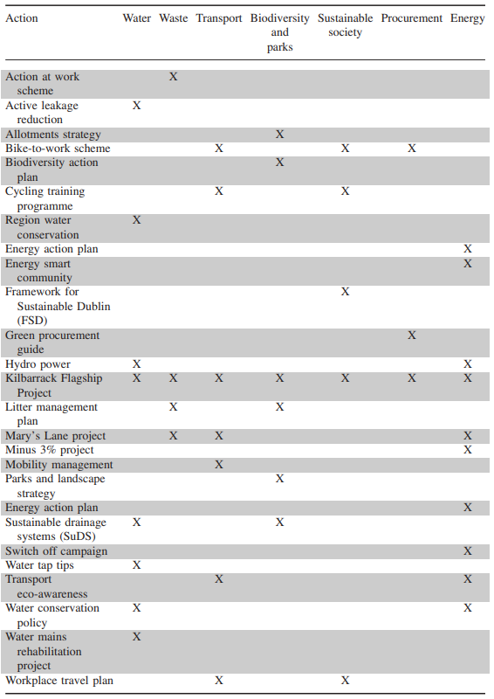
A Capability Maturity Framework for SICT

Slide 50
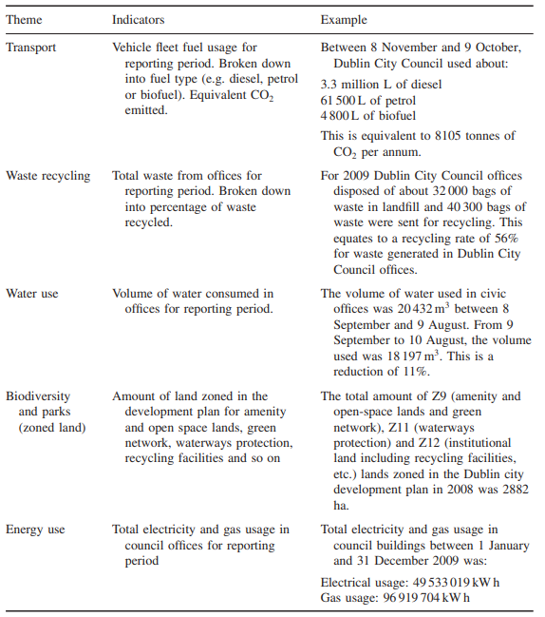

Slide 51
The SICT–CMF assessment methodology determines how SICT capabilities are contributing to the business organization’s overall sustainability goals and objectives.
This gap analysis between what the business wants and what SICT is actually achieving positions the SICT–CMF as a management tool for aligning SICT capabilities with business sustainability objectives.
The framework focusses on the execution of four key actions for increasing SICT’s business value:
Define the scope and goal of SICT.
Understand the current SICT capability maturity level.
Systematically develop and manage the SICT capability building blocks.
Assess and manage SICT progress over time

Slide 52
Defining the Scope and Goal
Firstly, the organization must define the scope of its SICT effort.
As a prerequisite, the organization should identify how it views sustainability and its own aspirations.
Typically, organizational goals involve one or more of the following:
Develop significant capabilities and a reputation for environmental leadership.
Keep pace with industry or stakeholder expectations.
Meet minimum compliance requirements and reap readily available benefits.
Secondly, the organization must define the goals of its SICT effort.
It is important to be clear on the organization’s business objectives and the role of SICT in enabling those objectives.
Having a transparent agreement between business and IT stakeholders can tangibly help achieve those objectives.
Significant benefits can be gained even by simply understanding the relationship between business and SICT goals.

Slide 53
Capability Maturity Levels
Initial:
SICT is ad hoc; there is little understanding of the subject and few or no related policies.
Accountabilities for SICT are not defined, and SICT is not considered in the system’s life cycle.
Basic:
There is a limited SICT strategy with associated execution plans.
It is largely reactive and lacks consistency.
There is an increasing awareness of the subject, but accountability is not clearly established.
Some policies might exist but are adopted inconsistently.

Slide 54
Intermediate:
A SICT strategy exists with associated plans and priorities.
The organization has developed capabilities and skills and encourages individuals to contribute to sustainability programmes.
The organization includes SICT across the full system’s life cycle, and it tracks targets and metrics on an individual project basis.
Advanced:
Sustainability is a core component of the IT and business-planning life cycles. IT and business jointly drive programmes and progress.
The organization recognizes SICT as a significant contributor to its sustainability strategy.
It aligns business and SICT metrics to achieve success across the enterprise.
It also designs policies to enable the achievement of best practices.

Slide 55
Optimizing:
The organization employs SICT practices across the extended enterprise to include customers, suppliers and partners.
The industry recognizes the organization as a sustainability leader and uses its SICT practices to drive industry standards.
The organization recognizes SICT as a key factor in driving sustainability as a competitive differentiator.

Slide 56
This maturity curve serves two important purposes.
Firstly, it is the basis of an assessment process that helps to determine the current maturity level.
Secondly, it provides a view of the growth path by identifying the next set of capabilities an organization should develop to drive greater business value from SICT.

